Slide 1
Airlines Data Analytics for Aviation Industry
Team Members
1. Benilton Azwalt B (951219104006)
2. Jenish Immanuel Raj J (951219104018)
3. Leeban Raj J (951219104027)
4. Thanga Selvakumar D (951219104054)

Slide 2
Problem Statement
To provide better Airline and AirPort services and to avoid delays in Air Travel across different locations at Municipality level. The aim is to provide airports, airlines, and the travelling public with a neutral, third-party view of which airlines are delivering on their promise to get passengers from Point A to Point B on-time.

Slide 3
Proposed Solution
For that purpose we use the method of data analytics and internet of things to store the data which is used for the needed. Data set of various countries , Number of flights based on continent , weather , region ,Air station , Number of airports that are suitable for the running of the flights are being collected in the form of the data sets and penned down in charts. In IBM Cognos cloud area the collected information is stored for further process. On following the collection of the data set those processed information are dropped in the spreadsheets. Using the given dataset, we plan to create various graphs and charts to highlight the insights and visualizations. On doing this a perfect information of the flights are obtained and many overhead delay of the arrival , departure of the planes can be avoided.

Slide 4
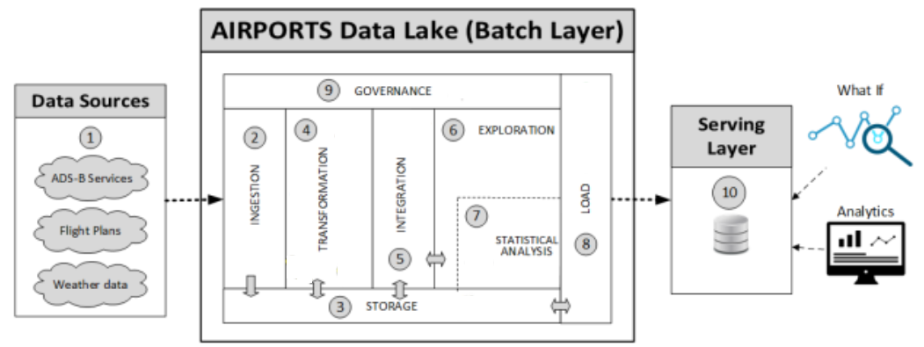
Solution Architecture

Slide 5
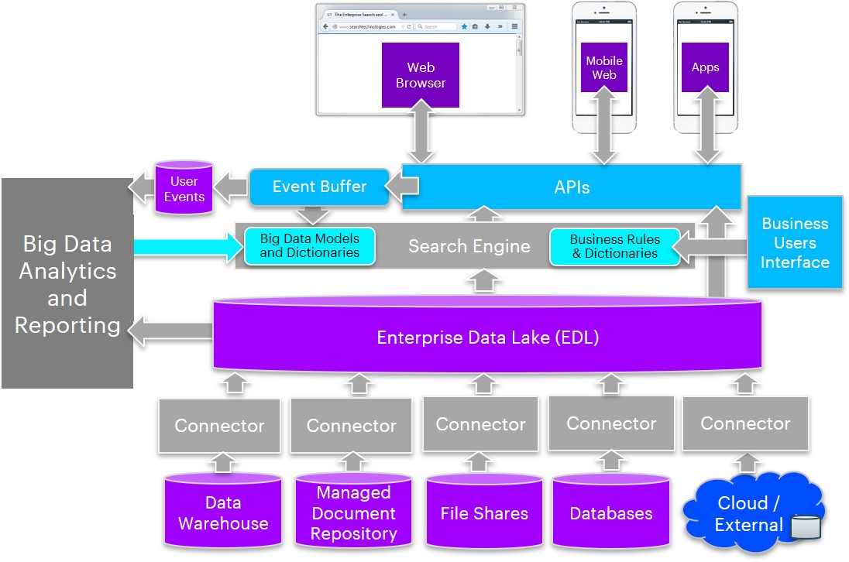
Technical Architecture

Slide 6
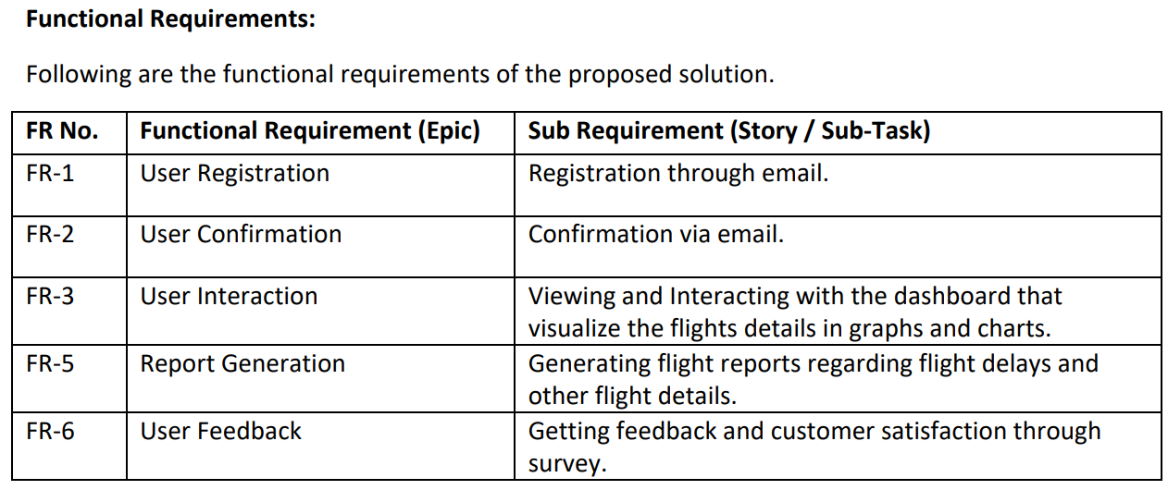
Functional Requirement

Slide 7
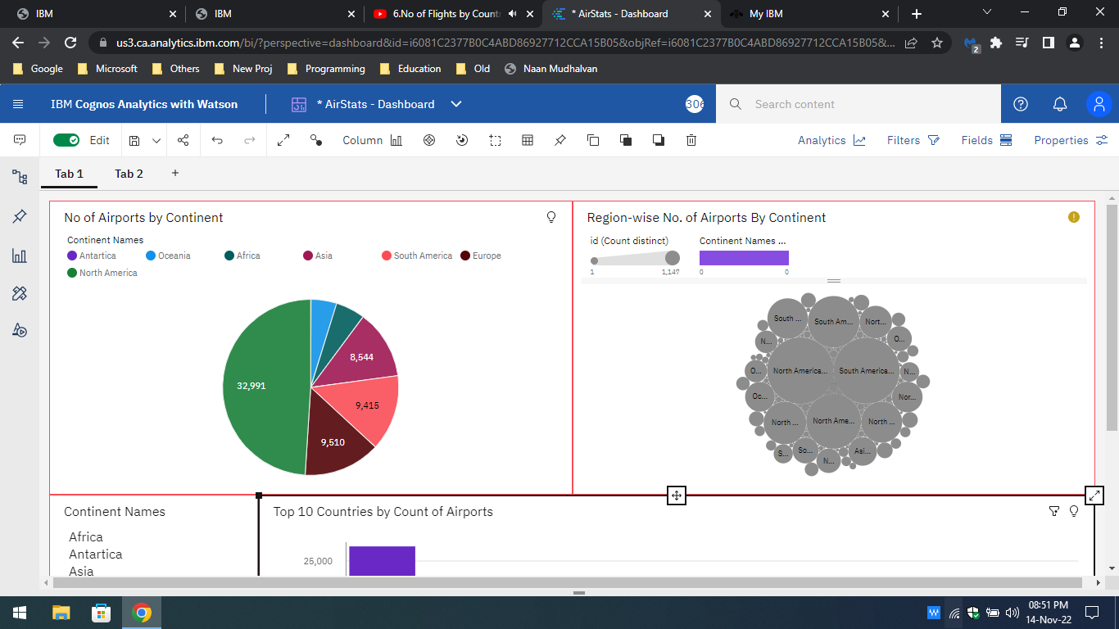
Screenshots

Slide 8
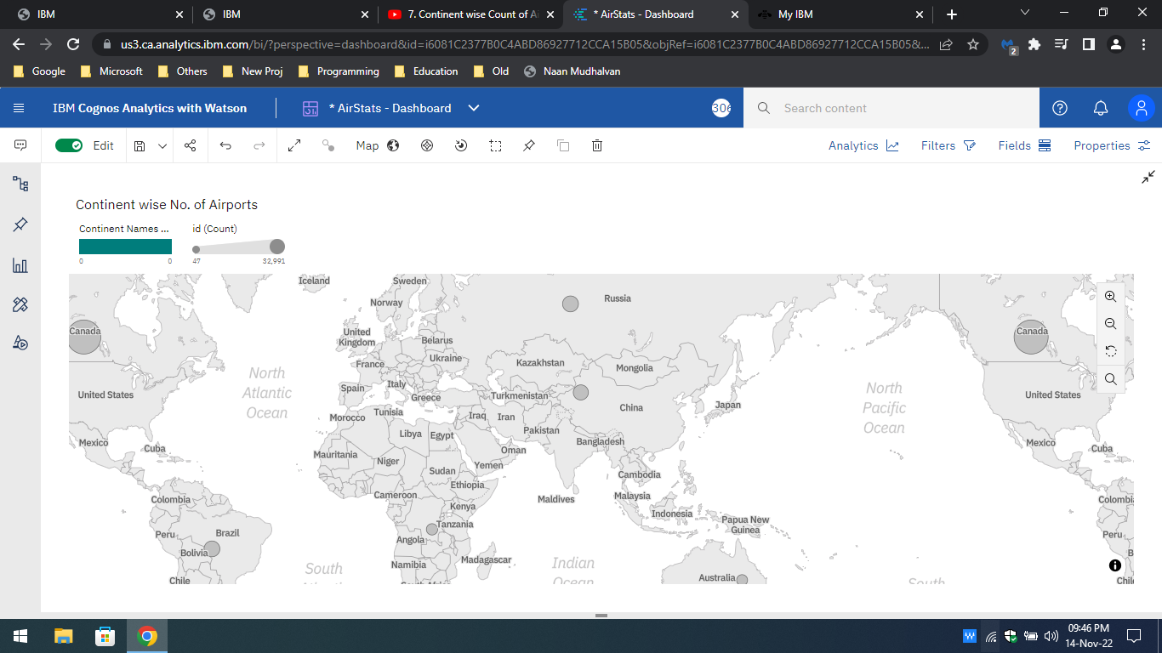

Slide 9
Future Scope
The future scope to add more sign-in option like third party login services like Facebook, Google etc,. and easy to access dashboard design and add features like multiple user login and other security and privacy updates by reducing user information collection and improving User experience and user interface. We also planning to port this web application into mobile application with Android and iOS versions.

